Slide 1
Creating a Successful Kickstarter Campaign
Data Science Admission
Anita Tran: 2019-10-10
Notes:
(based on a data analytics POV)

Slide 2
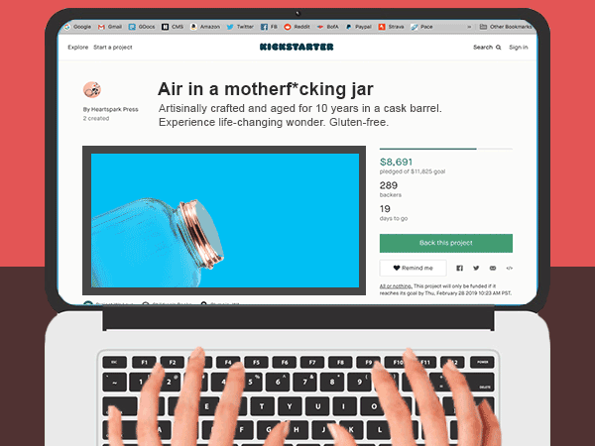
DISCOVERING THE OPPORTUNITY
With an average success rate of 47% not everyone is guaranteed to reach their Kickstarter goals. It takes a lot of work but you can tip the scales in your favor.
If you’re running a Kickstarter project, it’s important to market your idea to get the maximum number of backers. However, before you even get started with your project, you should plan ahead.
Here are some of the best tips for doing that, backed by Kickstarter data (2009 to 2012).
(opportunity) solution outcome
Notes:
https://thehustle.co/wp-content/uploads/2019/02/hears.gif

Slide 3
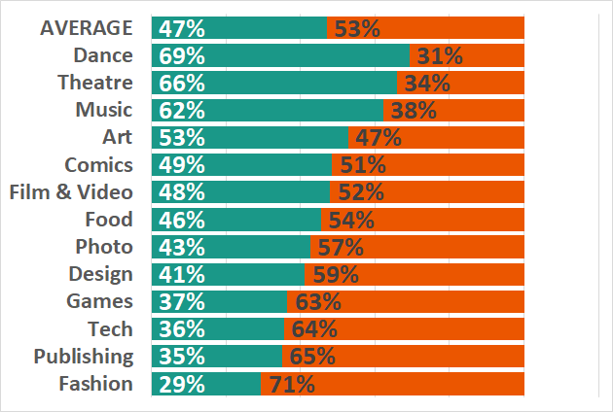
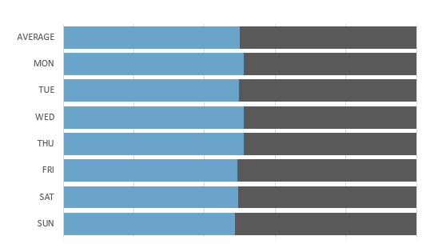
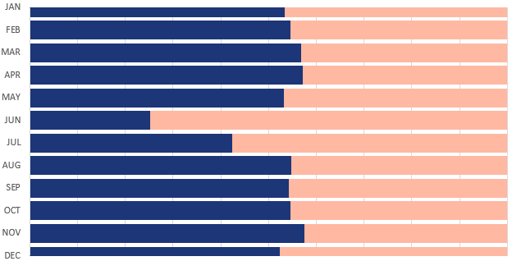
TREND ANALYSIS: THE BIG PICTURE
Understanding what category your creative project belongs within and that the timing of your product launch depends on your project and you. These are average success rates by:
Project type
Day of the week and month launch
successful
unsuccessful
successful
unsuccessful
successful
unsuccessful
50%
51%
47%
Average success rate for ALL 7 days in a week
Average success rate for ALL 12 months (minus June/July)
Of all projects are successful in meeting their funding goal - however this varies by project type
Pretty much anytime is a good time. When it comes down to it, the quality of your product and marketing is the most important
opportunity (solution) outcome
Notes:
Four categories — theater (60%), comics (57%), music (50%), and art (42%) — far outpace the average success rate, while tech (20%) lags far behind it.
The “all-or-nothing” nature of Kickstarter (only being permitted to keep funds if you meet the goal) seems to be a bit prohibitive for projects that require larger budgets (e.g. tech and food trucks).

Slide 4
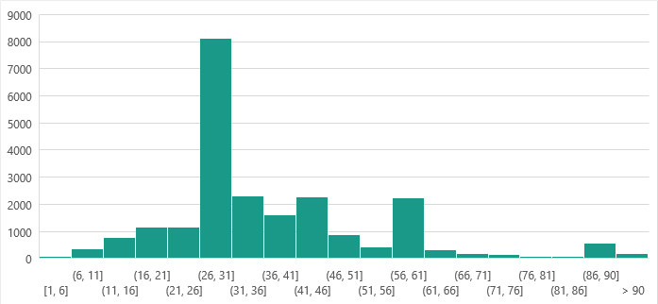
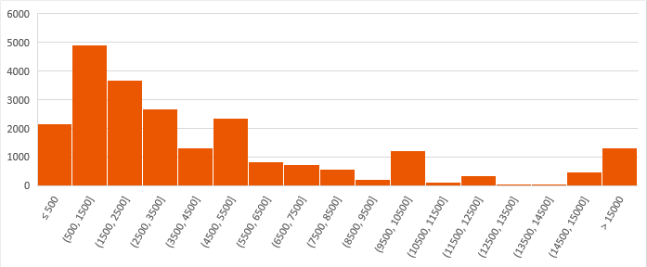
TREND ANALYSIS: WHEN SMALLER IS BETTER
Kickstarter is an “all-or-nothing” platform; you only keep the money when your goal is successfully met. Setting realistic time frames and campaign goals will lead to success.
Campaign duration (e.g. how long)
Campaign goal (e.g. how am I asking)
<$5,000 set goal
30 days
30 days
<$5,500
Is the ideal duration for successful projects
Set for a fundraising goal has proven to be most successful in meeting those
opportunity (solution) outcome
Notes:
https://thehustle.co/wp-content/uploads/2019/02/hears.gif

Slide 5
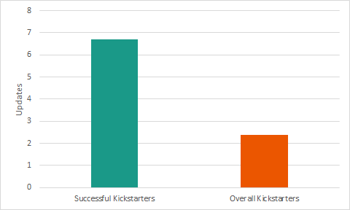
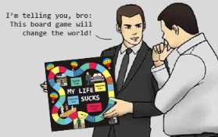
TREND ANALYSIS: KEY IS PEOPLE
Creating connection through your story and updates on your project will draw in not just any people but the people who are inspired by you and want to be inspired.
Update your backers and supporters
Quality and passion of the project
>7 updates
100%
Or more for your supporters - prove your appreciation
Be passionate, believe in your project and you will succeed
opportunity (solution) outcome
Notes:
https://thehustle.co/wp-content/uploads/2019/02/hears.gif

Slide 6
PUTTING IT ALL TOGETHER
Ultimately, this data reminds us that smaller goals are often more successful - however, only combined with your passion and drive. Let’s bring your creative project to life.
1. KNOWING YOUR PROJECT TYPE
4. CAMPAIGN GOAL
Among all projects, ~47% succeed - these rates vary widely by category. Keep in mind, the “all-or-nothing” nature of Kickstarter could be a bit prohibitive for projects that require larger budgets (e.g. tech and fashion).
The average successful project has a goal of <$5,500 and is nearly 50% lower than the average unsuccessful project.
1
4
2. TIMING OF CAMPAIGN LAUNCH
2
5
5. ENGAGE YOUR BACKERS
Your launch timing will not make much of an impact. Unless you had a successful “pre-campaign” (e.g. drop-type events), only then timing of the launch might help to boost.
Updates! Tune in with your backers constantly: Creators who update their backers every 5 days see a 3x increase in contributions.
3
6
3. PROJECT TIMELINE
6. BE AUTHENTIC & BRAG
The most successful campaigns are 30 days or less (max 60 days). Your timeline will dictate how long your Kickstarter campaign should run and how long it will take to deliver the finished product.
If you’re truly passionate about what you’re trying to create, it’s got to be at least a little bit shameless. Remember, no one will care about your Kickstarter if they can’t tell that you do.
opportunity solution (outcome)
Notes:
TITLE: IS kcikstarter right for you??
https://thehustle.co/crowdfunding-success-rate
#5 &6: other things found

Slide 7
Thank you.

